Slide 1

Data Structures
OPTIMIZATION LAB
2021-12-03

Slide 2


Content
Lists and Tuples.
Dictionaries.
NumPy Arrays.
N-dimensional arrays methods.
Conditions.
Loops.

Slide 3
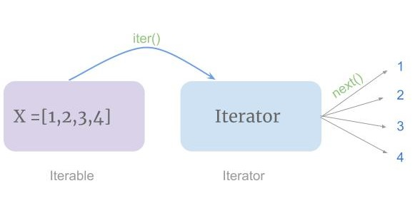
Iterable Objects
Return items one at a time.
Can support indexing.
Lists
Tuples
Dictionaries
Arrays
Strings

Slide 4
Built-in Functions for Iterables
sum()
sorted()
reversed()
any()
all()
max()
min()
enumerate()**
zip()**

Slide 5
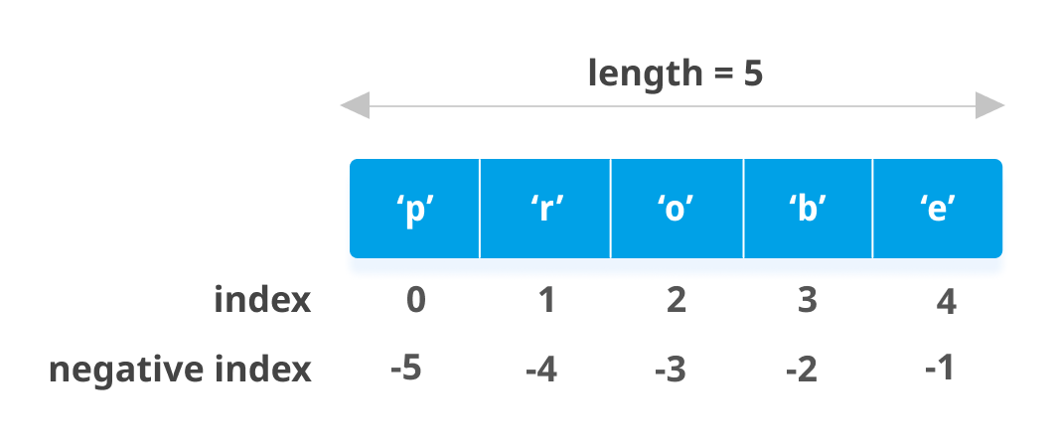
Lists vs. Tuples
Lists:
Collection of items.
Ordered.
Mutable:
Change items.
Add items.
Remove items.
Allows duplicates.
Tuples
Collection of items.
Ordered.
Immutable:
Items cannot be changed.
Cannot add items.
Cannot remove items.
Allows duplicates.

Slide 6
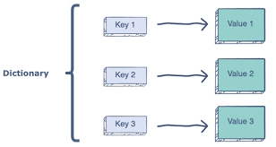
Dictionaries
Collection of items as key:value.
Ordered.*
Mutable.
No duplicates!

Slide 7

NumPy (Numerical Python)
Python library for arrays.
Numerical computing tools:
Linear algebra.
Fourier transforms.
Faster than lists.
N-dimensional array object (ndarray).
Broadcasting rules.**

Slide 8
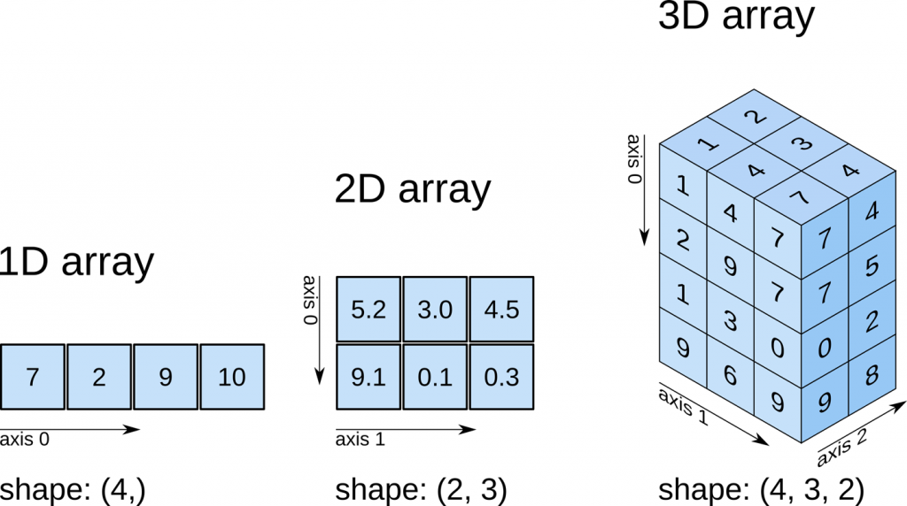
N-dimensional Arrays
Collection of items of the same type (dtype):
Basic types
General objects.
Usually fixed-size.
Optimized for mathematical operations.
Attribute shape.
Slicing and Indexing.

Slide 9
N-dimensional Arrays Methods
tolist()
reshape()
resize()
transpose()
flatten()
ravel()
take()
sort()
argsort()

Slide 10
N-dimensional Arrays Methods
nonzero()
diagonal()
max()
argmax()
min()
argmin()
clip()
round()

Slide 11
N-dimensional Arrays Methods
sum()
cumsum()
mean()
var()
std()
all()
any()

Slide 12
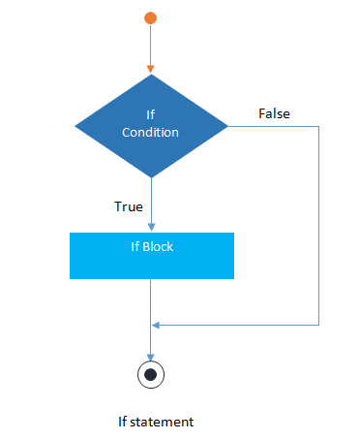
Conditions (if… else)
Logical conditioning:
Equals: a == b
Not equals: a != b
Less than (or equal to): a <= b
Greater than (or equal to): a >= b
Returns True or False.
Indentation is key!!!!

Slide 13
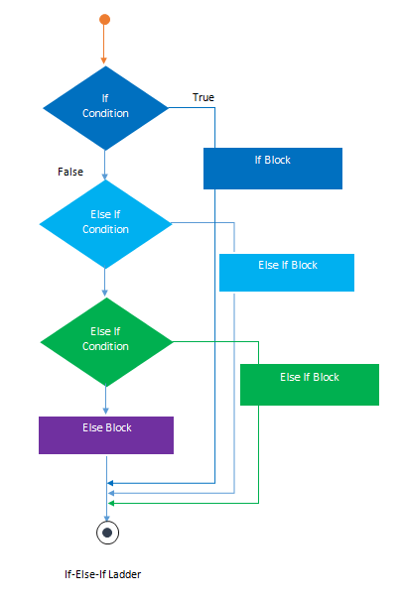
Conditions (if… elif… else)

Slide 14
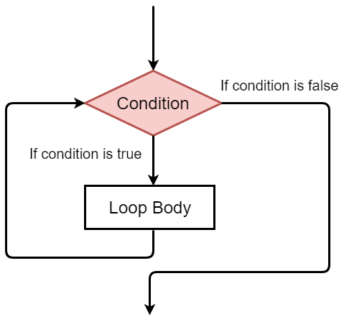
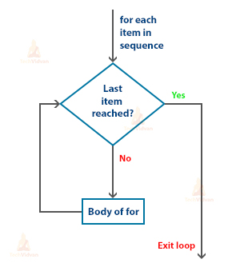
Loops
While loop:
Executes the block as long as a condition is true.
For loop:
Iterates through a sequence (iterable).

